Slide 1

Effective Heart Disease Prediction Using Hybrid Machine Learning Techniques
PRESENTED BY: PABBA ROHITH -123003172 -CSE
GUMPULA HRUTHIK KUMAR -123003072 -CSE
MARELLA VISHNU VARDHAN REDDY -123003133 -CSE
GUIDED BY : DR. SUDHA N(PROFESSOR, DEPT OF SOC, SCHOOL OF
COMPUTING , SASTRA DEEMED TO BE UNIVERSITY)

Slide 2
AGENDA
Base Paper Details
Problem Statement
Aim and Objectives
Abstract
Literature Survey
Proposed Methodology
Timeline
Implementation of Modules
References

Slide 3

BASE PAPER DETAILS:
Base paper URL : https://ieeexplore.ieee.org/document/8740989
Title of the Base Paper : Effective Heart Disease Prediction Using Hybrid Machine Learning Techniques
Journal : IEEE Access
Page no. : 81542-81554
Volume : 7
Year of publication : 2019
Author :SENTHILKUMAR MOHAN, CHANDRASEGAR THIRUMALAI,GAUTAM SRIVASTAVA

Slide 4
PROBLEM STATEMENT
Heart diseases can be managed effectively with a combination of lifestyle changes, medicines and even food habits. With the right treatment, the symptoms of the heart disease can be reduced and the functioning of the heart also becomes improved. The predicted results can be used to prevent and also reduce the cost for surgical treatment and other expensives and even the side effects are also reduced.
Due to the disease is related to the heart and also it is the most sensitive part the disease has to be handled carefully and also more faster way with a greater accuracy. So, we propose a model called HRFLM which is better in some of the parameters such as accuracy, specificity and in error control.

Slide 5
AIMS AND OBJECTIVES
AIM : Prediction of Heart Disease using proposed HRFLM(Hybrid Random Forest with Linear Model)
Objectives :
To identify the null values in the dataset and pre-process the data by removing the rows that contain the null values.
To convert the target variable into binary classification where 0 represents the absence of heart disease and 1 represents the presence of heart disease.
Training the dataset using Logistic Regression , Naive Bayes , Random Forest , Gradient boosted trees , Decision trees, SVM(Support Vector Machine) and calculating the performance metrices.
Identifying the best model based on the calculated performance metrices.
Using the best predicted model proposing a hybrid model to improve the accuracy and other performance metrices.
Plotting a graph for the performance metrices of various models and proving the hybrid model is the best.

Slide 6
ABSTRACT
Heart disease has become common cause for death in the modern world. This disease is caused irrespective of age in these days and if not controlled or predicted at the earlier stage then this can cause a great damage and even fatality of the person.
There are many techniques which are used to predict the heart diseases such as Genetic Algorithm, Decision Trees, Naive Bayes and even Neural Networks which gave valuable results. Since the disease is related to the heart it is more complex and more sensitive part, so the disease has to be handled very carefully and if the severity is more then the treatment has to be done immediately. So, this lead to implement an algorithm that is even more efficient than the above algorithms with such as accuracy etc., parameters.
So, the main objective of the current proposed model uses all the features without any restrictions on using the feature selection. The technique we used here is the hybrid model named HRFLM (Hybrid Random Forest with Linear Model) which is better than the above algorithms in some of the parameters such as accuracy, specificity and in error control.

Slide 7
LITERATURE SURVEY
S No | Paper title | Methodology | Limitations
1 | A. H. Alkeshuosh, M. Z. Moghadam, I. Al Mansoori, and M. Abdar, ‘‘Using PSO algorithm for producing best rules in diagnosis of heart disease’’ | PSO(Particular Swarm Optimisation) | High Computational efficiency Memory Low convergence
2 | J. P. Kelwade and S. S. Salankar, ‘‘Radial basis function neural network for prediction of cardiac arrhythmias based on heart rate time series,’’ | Radial basis function neural network | Classification is slow
3 | Y. . E. Shao, C.-D. Hou, and C.-C. Chiu, ‘‘Hybrid intelligent modeling schemes for heart disease classification,’’ | Logistic Regression& ANN | Accuracy is low

Slide 8
S No | Paper title | Methodology | Limitations
4 | R. Das, I. Turkoglu, and A. Sengur, ‘‘Effective diagnosis of heart disease through neural networks ensembles,’’ | Artificial Neural Networks | Computational efficiency is high
5 | P. S. Kumar, D. Anand, V. U. Kumar, D. Bhattacharyya, and T.-H. Kim, ‘‘A computational intelligence method for effective diagnosis of heart disease using genetic algorithm,’’ | Genetic Algorithm | Accuracy and efficiency is low
6 | K. Uyar and A. Ilhan, ‘‘Diagnosis of heart disease using genetic algorithm based trained recurrent fuzzy neural networks,’’ | Fuzzy neural networks | They work on inaccurate inputs and the accuracy is too low

Slide 9
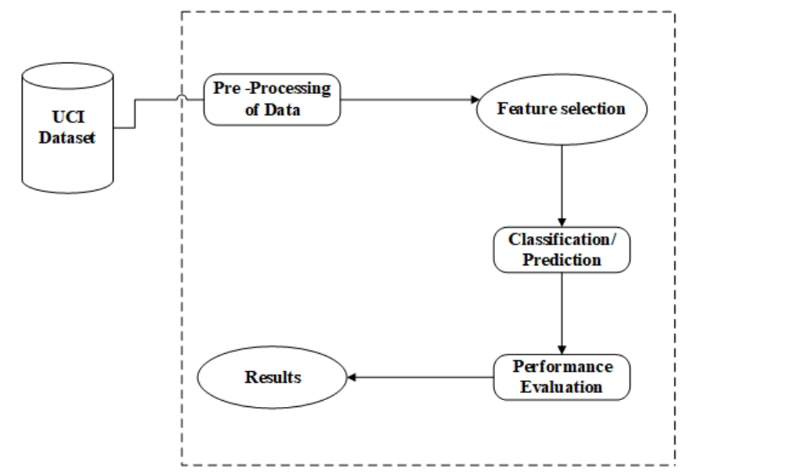
WORKFLOW

Slide 10
Proposed Methodology
Initially the UCI dataset is preprocessed by removing the rows which contain the null values.
Converting the target variable into binary classification where 0 represents the absence of heart disease and 1 represents the presence of heart disease.
Then the pre-processed dataset is then split into test and train data where the testing data is 15% of the whole pre-processed data.
Now the train data is trained to the model using various classification algorithms such as using Logistic Regression , Naive Bayes , Random Forest , Gradient boosted trees , Decision trees , SVM.
Now after training, the test data is given to the model and the result is predicted by the model.
Based on the results, the performance metrices are calculated such as classification error , accuracy, precision , F-measure , specificity and sensitivity.
The best model among these is taken for proposing the hybrid model.

Slide 11
EXPECTED OUTCOME
To detect the heart disease with high accuracy and low computational time.
Identifying the algorithms which are helpful in the hybrid prediction model.
SOFTWARE TOOLS REQUIRED
Anaconda(Jupyter notebook)
Streamlit

Slide 12
TIMELINE
Module | TASK | TIME
I | Identifying the problem statement and collecting dataset | 22nd March-10th April
II | Data preprocessing | 11th April-23rd April
III | Training the model using Logistic Regression , Naive Bayes , Random Forest , Gradient boosted trees and calculating performance metrices | 24th April-15th May
IV | Training the model using SVM, Decision trees and the proposed HRFLM | 16th May-5th June

Slide 13
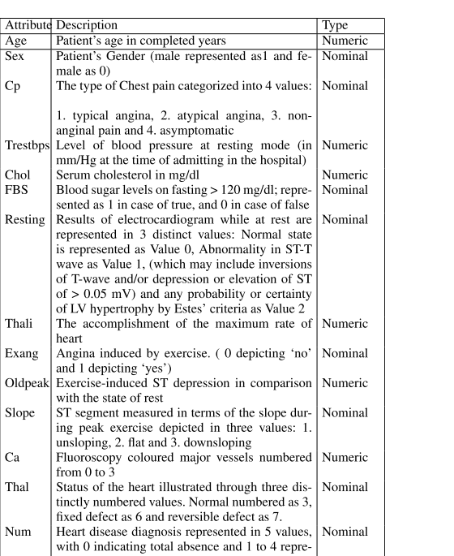
MODULE-1
The UCI dataset is used for training and testing the model.
Dataset Link: https://archive.ics.uci.edu/ml/datasets/heart+disease
Dataset attributes :

Slide 14
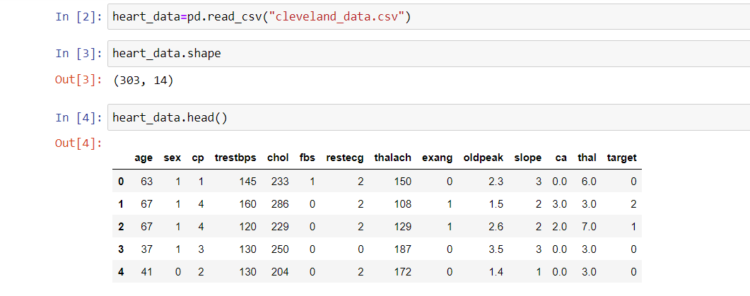
MODULE-2
This module forms the basis for the entire implementation part.
Data preprocessing for the UCI dataset is done.
The UCI dataset contains some null values in some rows. So all the rows that contain the null values are removed from the dataset.
First five records of UCI dataset before preprocessing

Slide 15
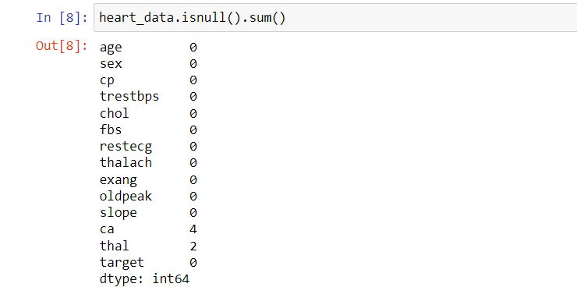
Null values are checked before deleting them
UCI dataset contains null values in 4 rows of ca and two rows of thal

Slide 16
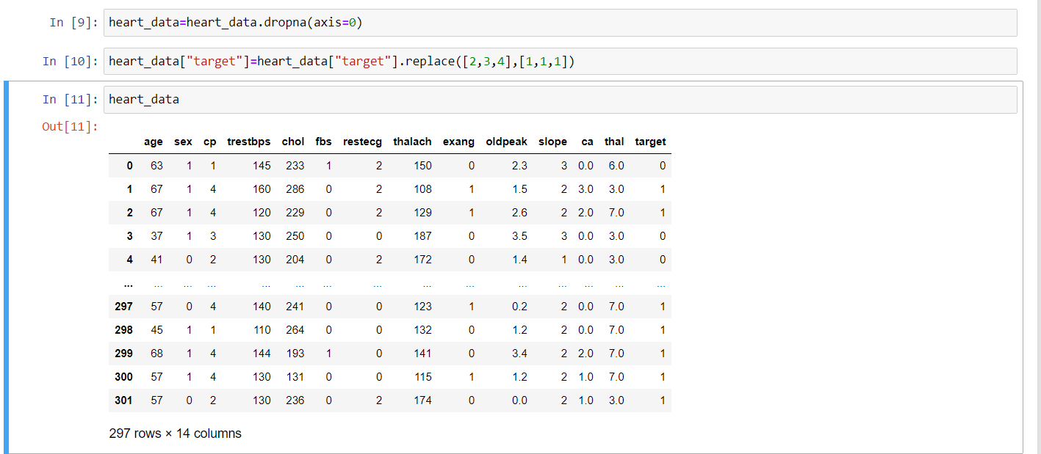
As a part of preprocessing rows containing null values are removed and target variable is converted to the range of(0,1)

Slide 17
Module-3
Now, the UCI dataset is splitted into training and testing data, the training data is taken as 85% of the whole data and testing data is 15% of whole data.
This training and test data is now used for training the model using Logistic Regression , Naive Bayes , Random Forest , Gradient boosted trees.
Now based on the results predicted by the model performance metrices such as classification error , accuracy, precision , F-measure , specificity and sensitivity are calculated.

Slide 18
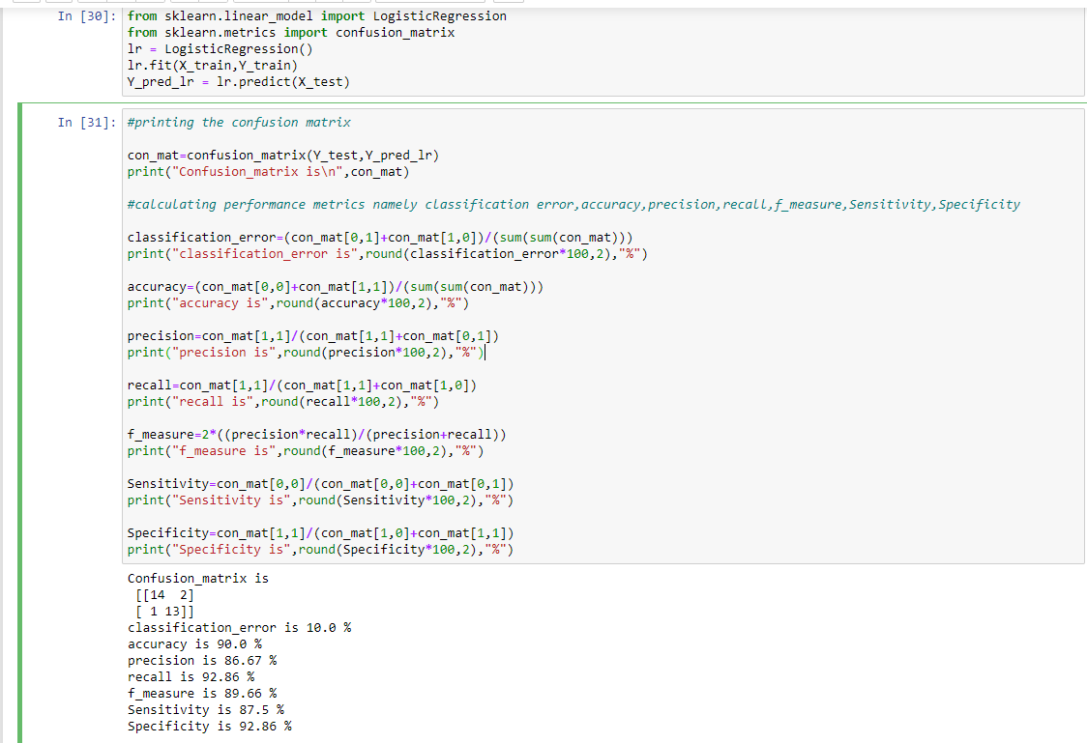
Logistic Regression

Slide 19
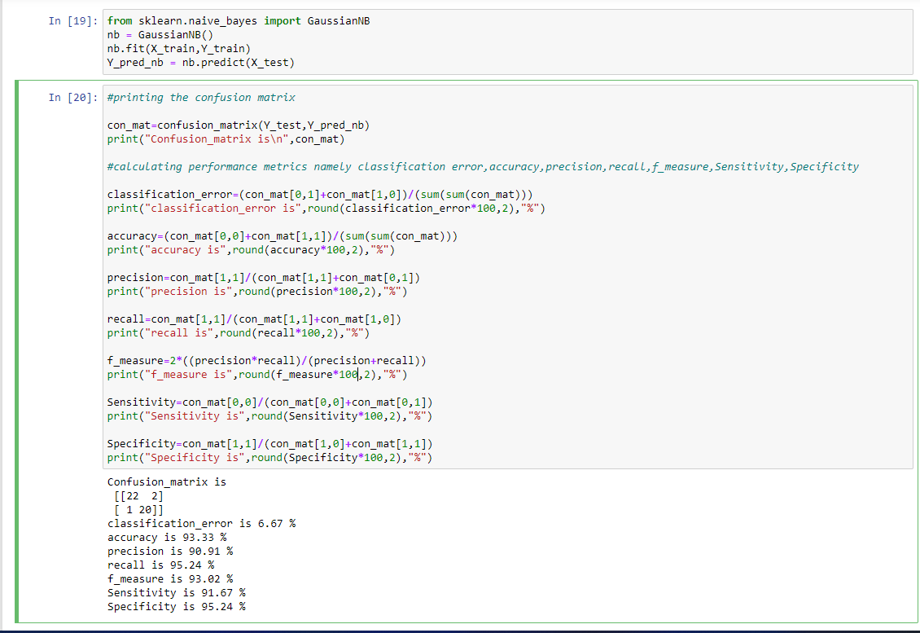
Naive Bayes

Slide 20
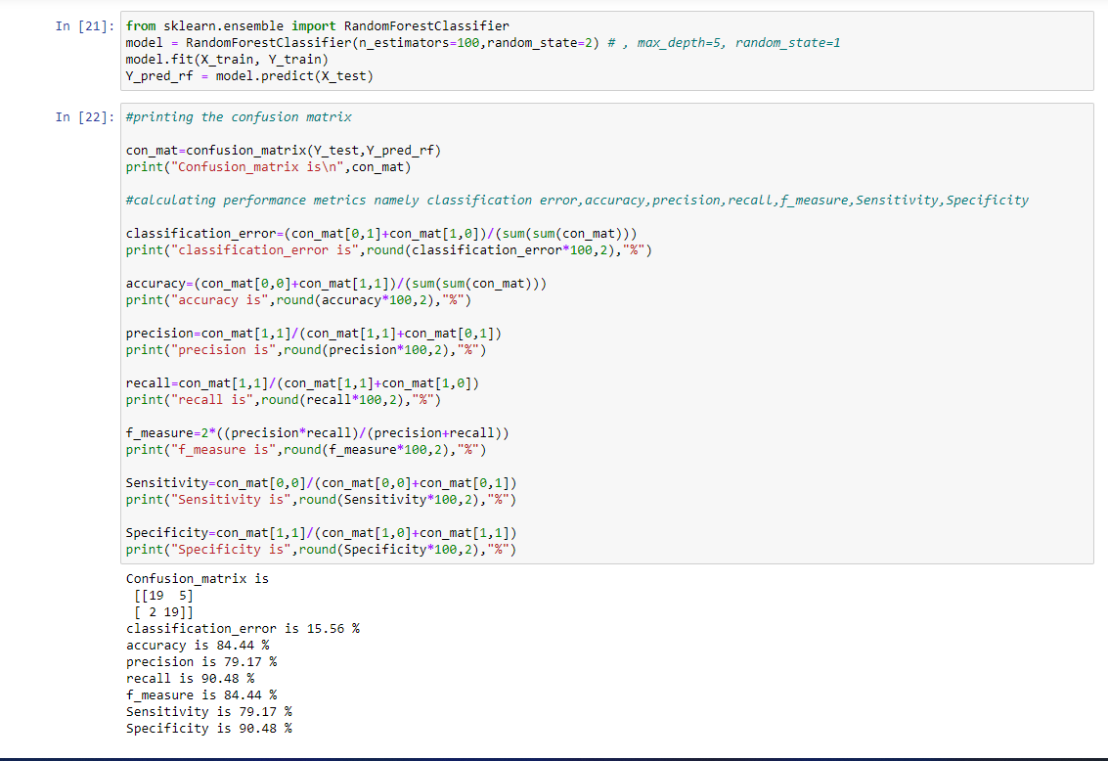
Random Forest

Slide 21
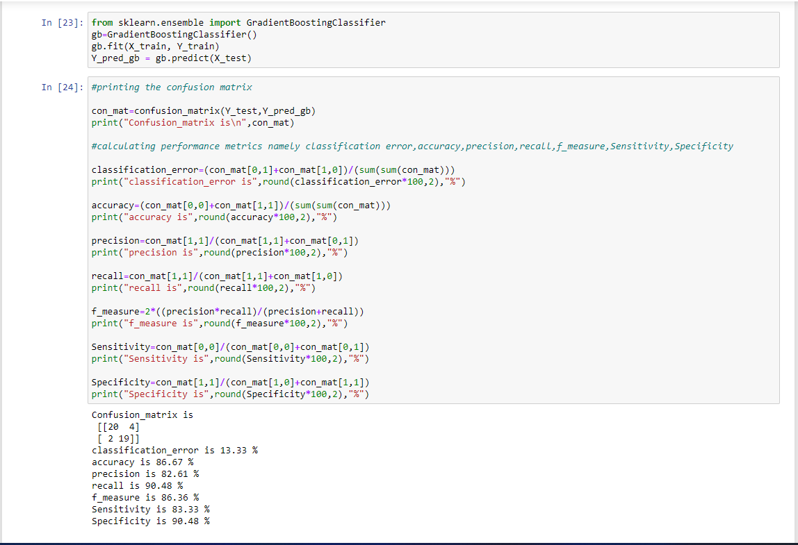
Gradient Boosted Trees

Slide 22
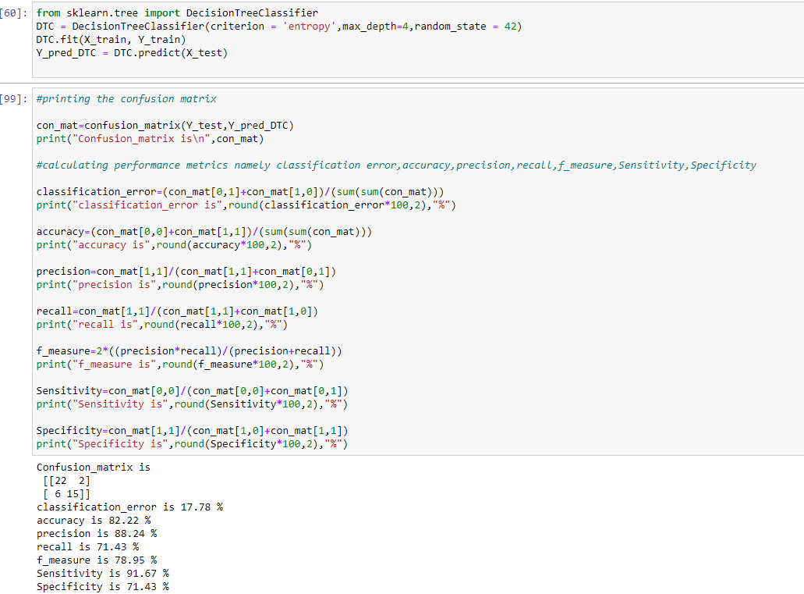
Decision Tree Algorithm

Slide 23
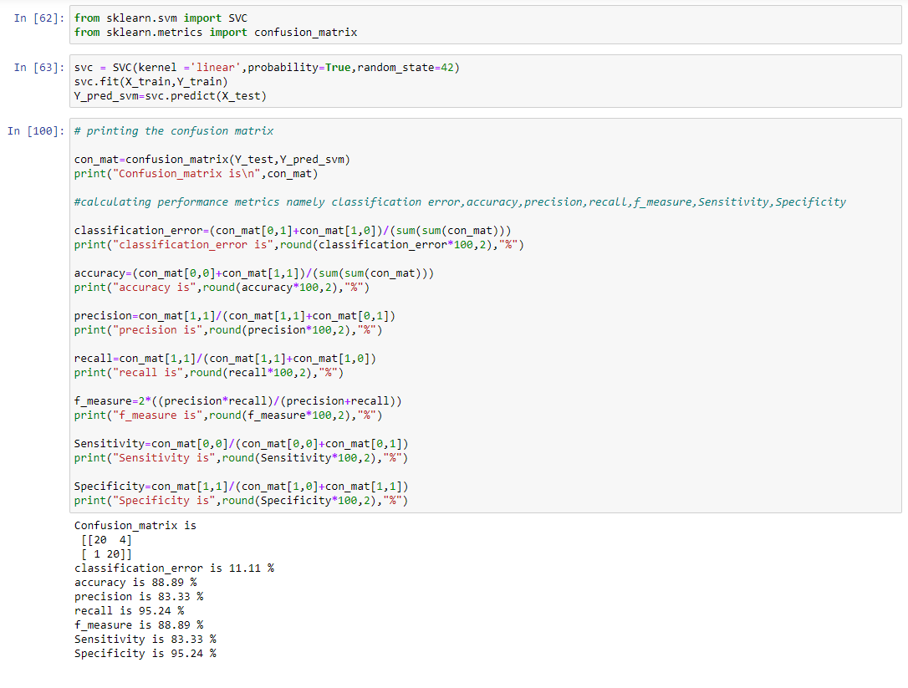
Linear Support Vector Machine(LSVM)

Slide 24
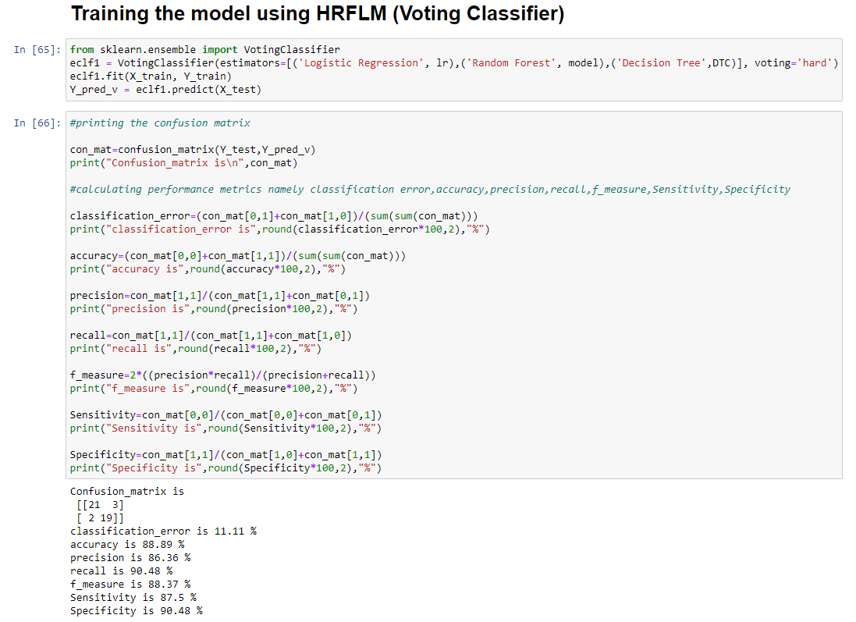

Slide 25
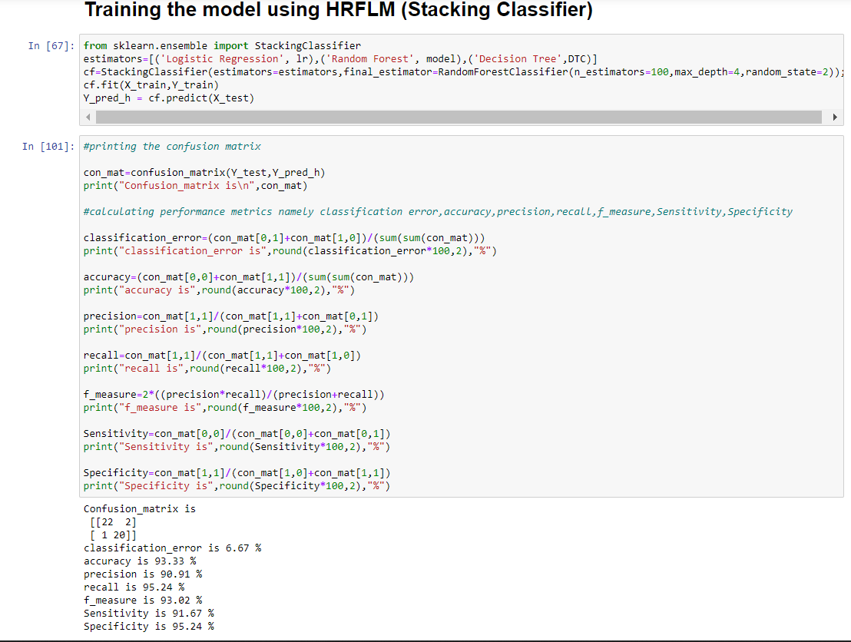

Slide 26
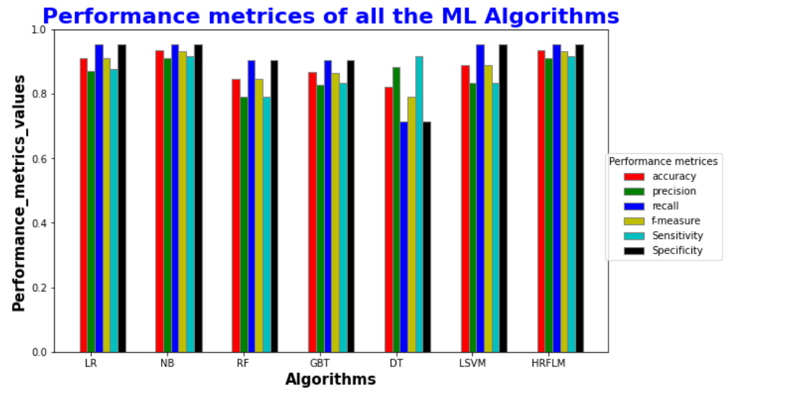
Graph of ML basic models with the hybrid model

Slide 27
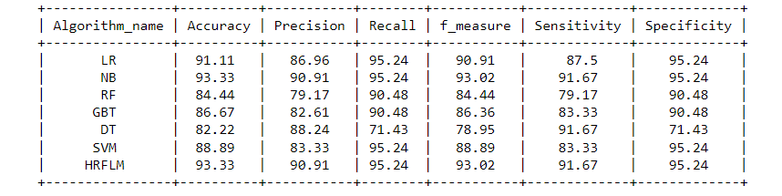
Results:

Slide 28
Conclusion
The number of heart disease cases are increasing steadily with the increased number of aged population
So, early detection of the disease is necessary
So , from the algorithms that we trained the data combined together that has highest accuracy and other performance metrices is taken into consideration for building the hybrid model(HRFLM)

Slide 29
References
A. S. Abdullah and R. R. Rajalaxmi, ‘‘A data mining model for predicting the coronary heart disease using random forest classifier,’’ in Proc. Int. Conf. Recent Trends Comput. Methods, Commun. Controls, Apr. 2012, pp. 22–25.
C. A. Devi, S. P. Rajamhoana, K. Umamaheswari, R. Kiruba, K. Karunya, and R. Deepika, ‘‘Analysis of neural networks based heart disease prediction system,’’ in Proc. 11th Int. Conf. Hum. Syst. Interact. (HSI), Gdansk, Poland, Jul. 2018, pp. 233–239.
H. A. Esfahani and M. Ghazanfari, ‘‘Cardiovascular disease detection using a new ensemble classifier,’’ in Proc. IEEE 4th Int. Conf. Knowl.- Based Eng. Innov. (KBEI), Dec. 2017, pp. 1011–1014.
F. Dammak, L. Baccour, and A. M. Alimi, ‘‘The impact of criterion weights techniques in TOPSIS method of multi-criteria decision making in crisp and intuitionistic fuzzy domains,’’ in Proc. IEEE Int. Conf. Fuzzy Syst. (FUZZ-IEEE), vol. 9, Aug. 2015, pp. 1–8.
A. Gavhane, G. Kokkula, I. Pandya, and K. Devadkar, ‘‘Prediction of heart disease using machine learning,’’ in Proc. 2nd Int. Conf. Electron., Commun. Aerosp. Technol. (ICECA), Mar. 2018, pp. 1275–1278.

Slide 30
THANK YOU

